Slide 2
Zero-Downtime Kubernetes Cluster Upgrade Solution
LINE Verda Platform Infrastructure Engineer
Ran Xu (littledriver)
Notes:
Hello, everyone. I am Ran Xu. I am Infrastructure Engineer in Verda Platform Team of LINE. We provide managed kubernetes service to LINE developers
In last year, with the increasing of users on the managed k8s service platform, we encountered different challenges. One of them is to provide a safe, flexible and zero-downtime kubernetes cluster upgrade solution to our users. Today, I will share how we think about cluster upgrade solution and how we design and implement it.
(around 50s)

Slide 3
About Me
Ran Xu (littledriver)
Joined LINE in 2019/09
Infrastructure Engineer Of Managed Kubernetes Service Team
Notes:
First of all, I would like to introduce myself. I joined LINE in Sep 2019. I was responsible for developing and maintaining LINE Managed Kubernetes Services platform. And I am also in charge of reliability improvement work within my team.

Slide 4
Architecture Of LINE Managed Kubernetes Service
Desired Cluster Upgrade Solution
Case Study: Rancher and Kubeadm
Managed Kubernetes Cluster Upgrade Solution
Agenda
Notes:
Here is the agenda of my topic today.
Firstly, I will introduce the architecture of LINE Managed Kuberentes Service
Secondly, I will share what’s desired cluster upgrade solution in our mind when we got this challenge
Thirdly, I will share investigation results on some OSS about how they do cluster upgrade work
Finally, I will introduce how we design and implement our own k8s cluster upgrade solution
(around 1min)

Slide 5

LINE Managed Kubernetes Service
Notes:
First of all, let me introduce the architecture of LINE managed kubernetes service

Slide 6

Overview of Managed Kubernetes
570 Clusters
8700 Nodes
Scale
10 Operators
Notes:
Now, we currently have about 570 clusters and over 4000 nodes managed by about 10 developers. Some of clusters already had more than 150 nodes. It is still increasing.

Slide 7






Overview of Managed Kubernetes
Add-on Management - Deploy - Monitor - Update
Private Cloud Users
Add-on Manager
Cluster Operation
- Cluster Create / Upgrade - Cluster Update / Delete - Worker Add / Delete
Automated Operating Multiple Clusters
Kubernetes
Kubernetes
GW-API
Cluster Management - Deploy - Monitor - Update - Upgrade
Kubernetes
Notes:
LINE managed k8s services platform includes 3 parts
GW-API: It’s responsible for handling the user’s request of cluster and node operation The gw-api doesn’t include the actual cluster/node operation logic, it just validates and forwards requests to backend cluster management service.
Rancher: The second part is Rancher. In LINE, we customize Rancher to be an automatic multiple-clusters management service.
Add-on Manager: The 3rd part is addon-manager. It’s responsible for deploying necessary control plane services that are mainly used by our operators, like fluentd, it helps us to collect necessary system components logs for better troubleshooting.
In LINE, We provide the single cluster for each development team or each business product.
After we knew architecture and scale info, let’s go to the cluster upgrade topic

Slide 8
Desired Cluster Upgrade Solution
Notes:
When we would like to have a cluster upgrade solution, we want to imagine a desired solution without considering any actual difficulties and existing experience first. Because, issues of cluster upgrade that each team encountered may be different. We don’t want experience limits our thought in advance.
So, let me share with you what’s desired cluster upgrade solution in our mind

Slide 9
Desired Cluster Upgrade Solution
Safety
Flexibility
Zero-Downtime
Notes:
A desired cluster upgrade solution should be safe, flexible, and no downtime on application side
I will explain what actual features that the desired cluster upgrade solution should include from those 3 perspectives one by one

Slide 10
Safety
Ensure new version satisfy the version skew policy of Kubernetes
Ensure the cluster is healthy before or after upgrade
Ensure no workload is broken due to API incompatibility
Notes:
In the safety part, the first feature we would like to have is upgradable checking. It is used to check if a cluster satisfies all upgradable conditions before we touched it.
The first checking item is k8s version skew checking. For example, skip multiple minor versions upgrade should be banned due to k8s doesn’t provide any compatibility promise on it
The second one is cluster health checking. We also should make sure that cluster doesn’t have any obvious issue before we touched it, like some of nodes are not ready before upgrade
The third one is resource compatibility checking. Because some of k8s APIs may be deprecated or removed eventually in the new version. In that case, if some user’s resource were created by them. It’s better to migrate those resources to the latest and compatible versions for avoid unexpected compatibility impact
2min 30s

Slide 11
Safety
Ensure the cluster can be rollback when unexpected issue happens before or after upgrade automatically and manually
Control plane and worker can be upgraded separately
Notes:
In addition to upgradable checking, the second feature we would like to have is cluster rollback mechanism
We hope the cluster can be rollback to the previous healthy state and k8s version when something was wrong during upgrade process automatically
Besides, manual rollback mechanism is also needed when user may finds some issues after the cluster was already upgraded, like their application cannot work on the specific k8s version due to compatible issues
The third feature is “upgrade control plane and worker separately”. As we know, User’s applications usually run on worker nodes. They may need to collaborate with control plane of k8s cluster, like sending request to kube-apiserver for creating or updating the specific resource objects. In that case, leaving enough time for user to check if their applications work fine or not with new version of control plane is necessary from safety perspective.

Slide 12
Flexibility
Select which workers and when to upgrade as users want exactly
Notes:
From the flexibility perspective,
We would like to support a flexible way to choose which workers nodes and when selected worker nodes are upgraded as user want. There are two reasons
Users sometimes just want to upgrade one or few worker nodes to new version and deploy testing applications on them to confirm if they works fine with new k8s version or not
Besides, some users will not upgrade worker nodes on the time period when there are more user requests. They will do it at mid night, or morning for reducing the reliability risk on applications

Slide 13
Zero-Downtime
Existing applications can serve internal/external network traffic during upgrade
Existing applications can communicate with control plane well during upgrade
Notes:
From “application” perspective, we hope our upgrade solution will not cause any downtime of applications.
Two conditions that our cluster upgrade solution should satisfy
external/internal network traffic can be handled by user’s application normally during upgrade
applications can communicate with the control plane well during upgrade process
That’s all we can come up with features that a desired cluster upgrade solution should include. After we already had this whole picture in our mind, we would like to check if some parts of our solution are already supported by OSS, so that we can re-use it for avoid the repeated work.

Slide 14
OSS Case Study
Notes:
Now, let’s go to the OSS case study part.

Slide 15
OSS Cluster Upgrade Solution
Safety
Flexibility
Zero-Downtime
Notes:
I will share the our investigation result of cluster upgrade solution on two OSS from perspectives where we consider our desired solution

Slide 16
Rancher
Notes:
As I mentioned, the LINE managed Kubernetes service is customized based on Rancher. It’s the first OSS that we investigated

Slide 17
Safety
Upgradable Checking
Support K8s system components health checking
No node ready state checking / version skew checking / compatibility checking
Separate Upgrade
Control Plane and Worker cannot be upgraded separately
Rollback
Support manual rollback only
Rollback is done by restore etcd snapshot and k8s version downgrade
Notes:
In the safety part,
For the upgradable checking feature, rancher only supports k8s system components checking, but not supports k8s version skew checking, node health state checking and compatibility checking
For the separate upgrade feature, rancher doesn’t support it. It means, once we triggered the upgrade process of a cluster, only two situations may happen
control plane upgrade failed and it is rollbacked. Worker will not be touched
control plane and worker will be upgraded in the single process
For the cluster rollback, rancher only supports manual rollback mechanism. It’s good due to user may wants to rollback cluster when they found something wrong after cluster is already upgraded
But, the disadvantage of no auto rollback mechanism is: rollback operation only can be be triggered until user or operator found the cluster is unhealthy. In that case, outage may happens on user’s application side during this period of time
Now, let’s go to the flexibility part

Slide 18
Flexibility
Control Plane
Upgrade control plane nodes at in batches of a configurable size (1~all)
Worker
Upgrade worker node at in batches of a configurable size (1~all)
Notes:
In flexibility part,
rancher provides batch size upgrade strategy for control plane and worker. It’s efficient in the huge scale cluster that has lots of control plane or worker nodes.
But, it reminds us, Rancher only can confirm the number of upgradable nodes at a time, but don’t confirm which nodes are selected and upgraded. This strategy is fine for control plane due to all of them should be upgraded in a single process. But it’s not flexible enough for workers. Because some of users want to upgrade few worker nodes where no production services are deployed on to test compatibility of new k8s version from application perspective

Slide 19
Zero-Downtime
Control Plane
Rolling Upgrade strategy ensures one control plane node is available for applications during upgrade
Worker
Rules related application workload in iptables are not changed during worker upgrade
Host / Cluster network are not touched during worker upgrade
Notes:
From “application” perspective, rancher picks up rolling upgrade strategy for control plane. it means the existing applications have one cp node to access during upgrade at least
And, because the network communication of applications rely on rules of iptables and cluster/host network stack, worker upgrade process will not touch them. It mean, Rancher provides the complete support for “zero-downtime” on application side
That’s all about rancher on cluster upgrade topic. You can see, it does something good, like providing automatic rollback cluster mechanism, but what it does on some points are still not enough, like upgradable checking.
For learning experience where rancher doesn’t do it well, we choose another popular OSS kubeadm as second object to investigate

Slide 20
Kubeadm
Notes:
kubeadm is k8s official cluster provision and upgrade tool. Lots of users are using it to construct their own private k8s cluster.
19min

Slide 21
Safe
Upgradable Checking
Support K8s system components health checking / node ready state checking / version skew checking
No support API compatibility checking
Separate Upgrade
Control Plane and Worker can be upgraded separately
Rollback
Support auto rollback only
Rollback is done by restore etcd snapshot and k8s version downgrade
Notes:
In the safety part,
For the upgradable checking feature, kubeadm supports the k8s system components health checking and node state checking. It’s not surprised kubeadm also supports the k8s version skew checking due to it’s k8s official solution.
For the separate upgrade feature, kubeadm not only supports upgrade control plane and worker separately, but also support upgrade multiple nodes with same role separately. For example, it can support upgrade control plane one by one manually
For the cluster rollback, kubeadm only supports automatic rollback mechanism, not support manual rollback. The auto rollback process is triggered when some errors happen during the upgrade

Slide 22
Flexibility
Control Plane
Upgrade control plane nodes one by one
Worker
Upgrade worker node one by one
Notes:
For the flexibility part, kubeadm does better than rancher on “upgrade time” and “selected nodes”.
But the disadvantage is, it doesn’t support batch size upgrade. It’s an operation disaster when a cluster includes hundreds, thousands nodes that need to upgrade.

Slide 23
Zero-Downtime
Control Plane
Rolling Upgrade strategy ensures two control plane nodes are available for applications during upgrade
Worker
Rules related application workload in iptables are not changed during worker upgrade
Host / Cluster network are not touched during worker upgrade
Notes:
Because flexibility of upgrade approach, rolling upgrade control plane is feasible in kubeadm. For worker, it’s same with rancher. So, there isn’t downtime issue on applications side.

Slide 24
Rancher (2.4.3) v.s Kubeadm
Notes:
Here is the table I made to summarize the behaviour of different OSS on necessary features

Slide 25


Tech Direction
A Safe cluster upgrade solution must be the highest priority
Good best practice we can reference from kubeadm
Notes:
For a safe cluster upgrade solution, rancher doesn’t do it very well. Kubeadm is better but it still missed some checking staff that we would like to have, like API compatibility checking.
Especially for the rollback mechanism, rancher and kubeadm have different advantages, but we want to have both of them in the single solution

Slide 26

Tech Direction
Flexibility is also mandatory requirement from our users
Notes:
For a flexible upgrade solution, rancher doesn’t do it well. But kubeadm also has some issues in choosing upgradable workers side.
It seems like no one OSS can satisfy all of our requirements for cluster upgrade solution. In that case, which direction we should go?

Slide 27
Tech Direction
Make cluster upgrade solution of Rancher (2.4.3) as basis to evaluate the gap between it and our desired solution
Improve features of cluster upgrade that Rancher already developed and develop new features that Rancher missed
Get best practices from OSS (kubeadm) for cluster upgrade
Notes:
Finally, we choose a “fusion” way
We use rancher’s cluster upgrade solution implementation as basis and improve rancher’s logic that doesn’t implement necessary features completely. If there is any feature that Rancher missed, we can implement a new one as plugin in Rancher by reference the best practice of other OSS.
Now, it’s time to talk about how our upgrade solution looks like and how it works

Slide 28
Managed Kubernetes Cluster Upgrade Solution

Slide 29
Separate Upgrade
Control Plane
Worker
Notes:
The first improvement that we implemented on rancher side is separating the upgrade process of control plane and worker.
The control plane will be upgraded first. Then user can choose when and which worker nodes are upgraded

Slide 30
Control Plane Upgrade Phase
Pre-Upgrade
Upgrade Control Plane
Post-Upgrade
Upgradable Checking
Auto Backup
Rolling Upgrade Control Plane
Upgrade Network Plugin
Auto Rollback when the any error happens
Cluster Health Checking
Manual Rollback when any issue happens
Notes:
control plane upgrade logic in our solution can be explained by 3 phases
pre-upgrade
upgrade
post-upgrade
I will introduce which improvement we did for rancher existing feature and which new feature we added in each phase. Then, I will introduce the upgrade flow in the simple way
24min

Slide 31


Pre-Upgrade — Version Skew Checking
Control Plane
Worker
new patch - old patch > 0
new worker <= new CP
new minor - old minor = 1
Cluster 1(major.minor.patch)
Notes:
The first new feature of upgradable checking we introduced in pre-upgrade phase is k8s Version Skew checking. We implement it by reference the similar logic in kubeadm.
Two conditions we set
upgrade control plane/worker can across multiple patch versions or one minor version at most
the new version that worker node wants to go isn’t greater than current version of control plane
- they are mandatory rules. If the new version doesn’t satisfy those conditions, upgrade process will be stopped.

Slide 32






Pre-Upgrade — Compatibility Checking
Cluster 1
vksctl upgrade check -c <cluster_id> --version v1.15.11 {
"warning": {
"daemonsets": {
"apps/v1beta2": [
"daemonsets resources will no longer be served from extensions/v1beta1, apps/v1beta1, or apps/v1beta2 in v1.16. Migrate to the apps/v1 API, available since v1.9"
]
}
},
"error": {}
}
Kubernetes Release Note
Kubernetes Deprecated API List
Actual Resource List
Compatibility Report
Affected Resource Compatibility Report
Notes:
The second new feature we implement in upgradable checking part is compatibility checking.
When we plan to provide new version, we usually get the compatibility change from change log of new version and deprecated API list in k8s official doc
Then, convert them into the compatibility report in json format manually. Because the deprecation of API doesn’t happen on each k8s version, the manual work isn’t too much
Next, we get the actual resource list in user’s cluster and compare it with compatibility report to return the affected resource part to users. It includes which resource are affected and fixing suggestion
If any compatible issue still exist, upgrade process will not be proceeded

Slide 33
Pre-Upgrade — Cluster Health Checking
Kubernetes
etcd
Node
Scheduler
etcd
UnHealthy Condition
brain-Split
/healthz
/healthz
DiskPressure
Kube-apiserver
MemPressure
/healthz
State
Kube-controller-manager
Ready
/healthz
heart-beat
Kubelet
/healthz
Kube-Proxy
/healthz
Notes:
For the cluster health checking, rancher already implement it partially. So, we just did a small improvement
We add etcd brain-split checking by detect if multiple leaders exist in same etcd cluster
We also added the node unhealthy condition and state checking by reference kubeadm logic
The cluster health checking is not only used in pre-upgrade phase, but also used in post-upgrade phase. It’s for ensuring upgrade staff doesn’t break the user’s cluster
That’s all new features and improvements we did based on rancher in pre-upgrade phase. Now, let’s check how upgrade control plane / worker flow looks like

Slide 34
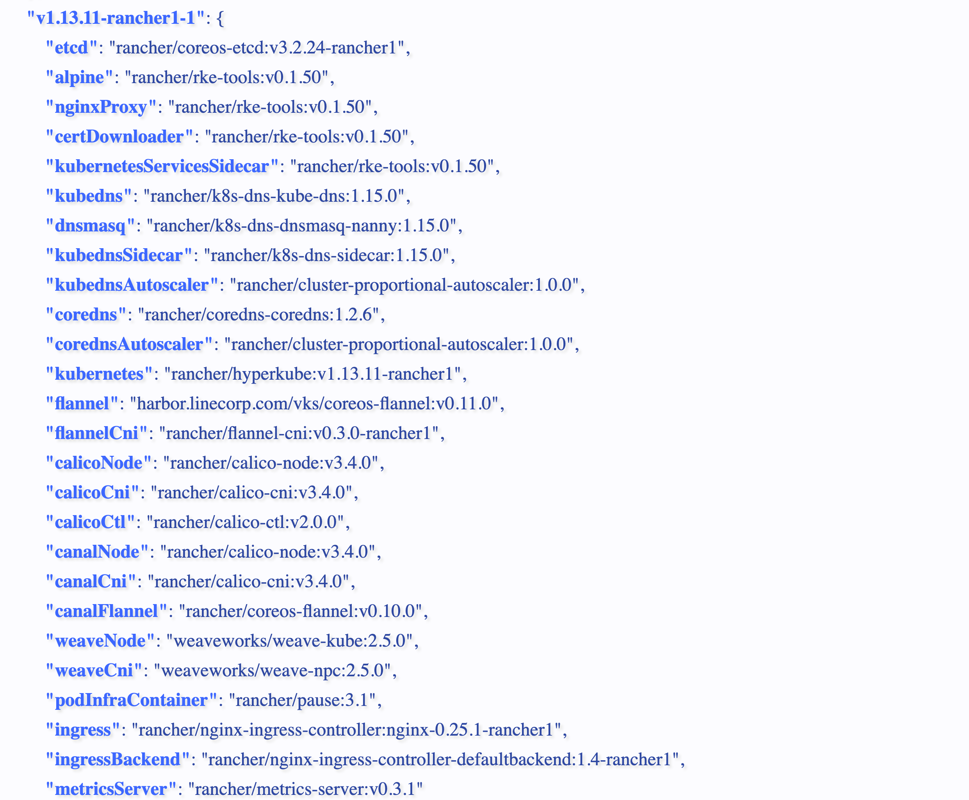







Upgrade Control Plane — Successful
Get Component Image List
Upgradable Checking(Version Diff)
Cluster Health Checking
Upgrade etcd
Upgrade Network Addon
kube-controller-mgr
kube-apiserver
kube-apiserver
kube-controller-mgr
Upgradable Checking(Version Diff)
Rolling Upgrade Control Plane Node
kube-scheduler
kube-scheduler
kube-proxy/kubelet
kube-proxy/kubelet
Notes:
In upgrade control plane phase, a successful upgrading control plane workflow is like this
It will get the necessary image map based on the desired k8s version. Here is the example. Because some of control plane softwares we are using are only compatible with specific k8s versions. It means, those softwares need to upgrade when we upgraded the control plane.
Then, it will check if the etcd needs to upgrade by diff the expected image version of etcd and the current versuib. If it needs, do rolling upgrade on etcd side. The frequency of etcd upgrade is not high due to one specific etcd version is usually compatible with several k8s cluster versions
After that, it will do the rolling upgrade on k8s system components and control plane softwares on control plane
Finally, it will proceeds the cluster health checking I mentioned in pre-upgrade phase to ensure cluster is healthy after control plane upgraded
The whole process will be done automatically.

Slide 35





Upgrade Control Plane — Failed
Get Component Image List
Rollback Control Plane
Upgradable Checking(Version Diff)
Cluster Health Checking
Upgrade etcd
Rolling Upgrade Control Plane Node
kube-controller-mgr
kube-apiserver
kube-apiserver
kube-controller-mgr
Upgradable Checking(Version Diff)
Rolling Upgrade Control Plane Node
kube-scheduler
kube-scheduler
kube-proxy/kubelet
kube-proxy/kubelet
Notes:
The control plane upgrade flow I explained is successful one. When something goes wrong during upgrade, rollback mechanism will be triggered automatically
Any Step that is marked as purple color is failed, auto rollback will be proceeded.
Now, let me introduce how cluster rollback process works

Slide 36







Upgrade Control Plane — Rollback
Get Component Image List
Cluster Health Checking
Shutdown etcd
Downgrade Network Addon
kube-apiserver
kube-apiserver
kube-controller-mgr
kube-controller-mgr
Shutdown Control Plane (at the same time)
Downgrade Control Plane
kube-scheduler
kube-scheduler
kube-proxy/kubelet
kube-proxy/kubelet
Download Snapshot
Downgrade & Restore etcd
Notes:
Unlike the upgrade process, the rollback process has downtime. Because rollback process needs to restore the etcd using the snapshot we took before. All etcd instances will be shutdown during that time
In addition to etcd restore work, rollback mechanism will also downgrade the k8s system components and other control plane softwares, like DNS and CNI plugin to the previous version.
Finally, cluster health checking will also be proceeded for make sure rollback healed the cluster. If the auto rollback still cannot make the cluster back to health, it will trigger the alert and involve operators to do the troubleshooting work

Slide 37







Post-Upgrade — Rollback (Manual)
`vksctl rollback controlplane -v <new-version>
Restore Etcd
Downgrade Control Plane
Cluster Health Checking
Downgrade Network Addon
Notes:
The manual rollback is usually triggered by users in post-upgrade phase, when they found their applications cannot work with new version of control plane, especially for kube-apiserver. They will execute the vksctl command to rollback control plane. vksctl is just similar command line tool with kubectl. It is provided by us to our users to do cluster/node operation.
That’s all staff I would like to share about control plane upgrade process. Now, let’s go to the worker upgrade part

Slide 38

Worker Upgrade Phase
Pre-Upgrade
Choose Worker
Upgrade Worker
Post-Upgrade
Version Skew Checking
Label Candidate Worker
Specify Node Selector
Upgrade Worker
Cluster Health Checking
Notes:
For the worker upgrade, I will skip Pre-Upgrade and Post-Upgrade phase. Because they are almost same with control plane. I will focus on choose candidate worker and upgrade worker phase

Slide 39






Choose Worker — node Selector
worker-1
worker-1
worker-1
worker-2
worker-2
worker-2
worker-3
worker-3
worker-3
labels:
worker: true
labels:
worker: true upgrade: true
labels:
worker: true upgrade: true
`vksctl get nodes -l worker=true`
`vksctl label nodes worker-2 worker -3 upgrade=true`
`vksctl upgrade worker -v <new-version> —nodeSelector upgrade=true`
Notes:
In choose worker phase, we implement the feature of “using node label selector to choose upgradable workers”. Our user can choose to add new, or use the existing labels to mark upgradable nodes. It’s not only supports batch size upgrade, but also confirm which workers will be upgraded.
One of example is in here: I used vksctl to label worker-2 and worker3 with upgrade=true, after I ran the final command, both of them will be upgraded at the same time.
So, what’s happened in worker upgrading process

Slide 40







Upgrade Worker
Get Component Image List
UnCordon Node
Build Up Desired Node Plan
Upgradable Checking(Version Diff)
Node State Checking
kubelet
kube-proxy
kubelet
Migrate App (Drain Node)
Upgrade Worker
kube-proxy
Notes:
Here is the complete upgrade work flow looks like
First, It will get the necessary image list based on the desired k8s version.
second, it will build up an object called node plan. This node plan includes the desired image and argument list of kubelet and kube-proxy and some necessary files that rancher has to create on host, like kube-api certificates
then , it will check if the kubelet/kube-proxy needs to upgrade by diff the expected image version and actual version
After that, it will execute `kubectl drain node <node-name> —ignore-daemonsets` command to migrate existing applications on that node and new applications will also not be scheduled to it
next, it will upgrade kubelet and kube proxy with new version image and proceed the health checking.
Finally, after confirmed worker node is upgraded successfully, it will add it back to cluster by uncordon it.
That’s all about how our cluster upgrade solution works and which features and improvements we did. Now, let’s check how it behaves compared with rancher and kubeadm

Slide 41
LINE v.s. Rancher v.s. Kubeadm
“Twemoji” ©Twitter, Inc and other contributors (Licensed under CC-BY 4.0) https://twemoji.twitter.com/
Notes:
Here is the table that compares LINE with OSS in cluster upgrade solution. Our upgrade solution supports all desired features
The hammer emoji indicates we improved rancher existing logic. The sparkles indicates it’s completely new feature we introduced to our custom rancher.

Slide 42
Thank you
Notes:
That’s all I would like to share with you. Thanks for your listening

